Slide 1
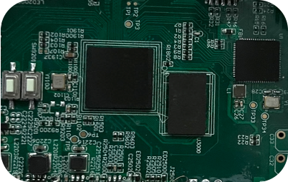
DL-16 / DL-08
AES67 Audio Network Module
DL-08 / DL-16
8x8 / 16x16 Channel Audio Network Module
Applications: integrated into processor, microphone, amplifiers, speakers and various audio products
192K
DSP
Ultra-low
Latency
Lossless Sound Quality
48/96/192KHZ
Sampling Rate
Powerful DSP Functions
DigisynLink™ = Network+DSP
Advanced, Stable, Customizable
Audio products with DL-08/DL-16 module integrated can easily fit into existing local area network and automatically discover other DigisynLink™ enabled devices on the same network.
DigisynLink™ module support the DSP function, according to the different requirement, includes: EQ, Delay, Mixer, AFC, Crossover, Fir.
Your products will be advanced with more potentials and lower product maintenance and operation cost.
Benefits
AES67 protocol, no server required, IP assigned automatically ,Auto-discovery with Software
Auto recovery from disconnection or power lost
Superb audio performance with lossless sound quality
Bundled with friendly GUI software ,fully visual operation interface: drag-line signal routing, equipment debugging and management
API with documentations for third-party automation/integration*
Continuously OTA firmware update
DSP Studio Software and Algorithms Up-To-Date
Sampling rates, segment of EQ, delays and other DSP function optimization.
Built-in future: Airplay, ANC etc*
Life time OTA update
Stable and Sustainable Supply
Flexible functional architecture, the core technology supports various platforms, DigisynLink can achieve long-term stable supply
All In One Powerful Visual Management Software
Implemented in a DigisynLink software: the whole system visual signal connection, all equipment configuration and function management.
Subscribe to
DigisynLink
Website：www.digisynlink.com
* API will be available by Q3 2022
www.digisynlink.com

Slide 2
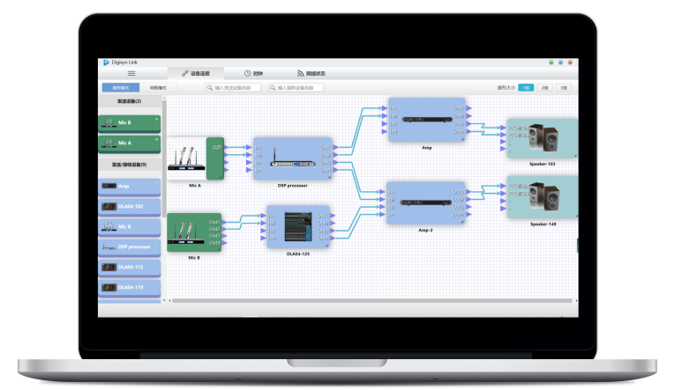
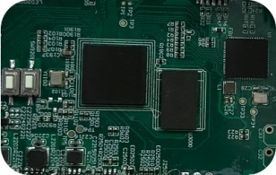
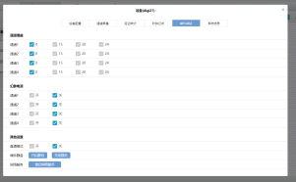
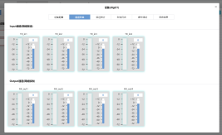
DL-16 / DL-08
AES67 Audio Network Module
SPECIFICATIONS
Audio Capabilities
Sample Rates
44.1/48/88.2/96/176.4/192kHz
Audio Channels In/Out
(44.1/48kHz)
Up to 16x16 channels
Audio Channels In/Out
(88.2/96kHz)
Up to 8x8 channels
Audio Channels In/Out
(176.4/192kHz)
Up to 2x2 channels
Audio Flows In/Out
Up to 32x32 simultaneous streams
Digital Audio Format
TDM, I2S*
Audio Transport Format
AES67 RTP, Digisyn network audio
Sample Bit Depth
32bit/24bit/16bit
Clocking
Onboard word clock
DSP Function
PEQ, Delay, Mixer, AFC, Crossover, Fir, etc.
Hardware
Form Factor
4.5cm x 5.5cm
Clock
High quality, low jitter
Physical Connector
Mini-PCI, BTB connector
Power
5V DC 2W
Interfacts
Control Interfaces
SPI, GPIO, UART
Network
RMII
* API, 8x8@96kHz, 2x2@192kHz features will be available by Q3 2022
Digisynthetic Co., Ltd
* Only DL-08 supports I2S
Address: 6116 Del Robles CT, San Jose, CA 95119
Email: info@digisynthetic.com
Phone: 518-244-0383
www.digisynlink.com

